Slide 1
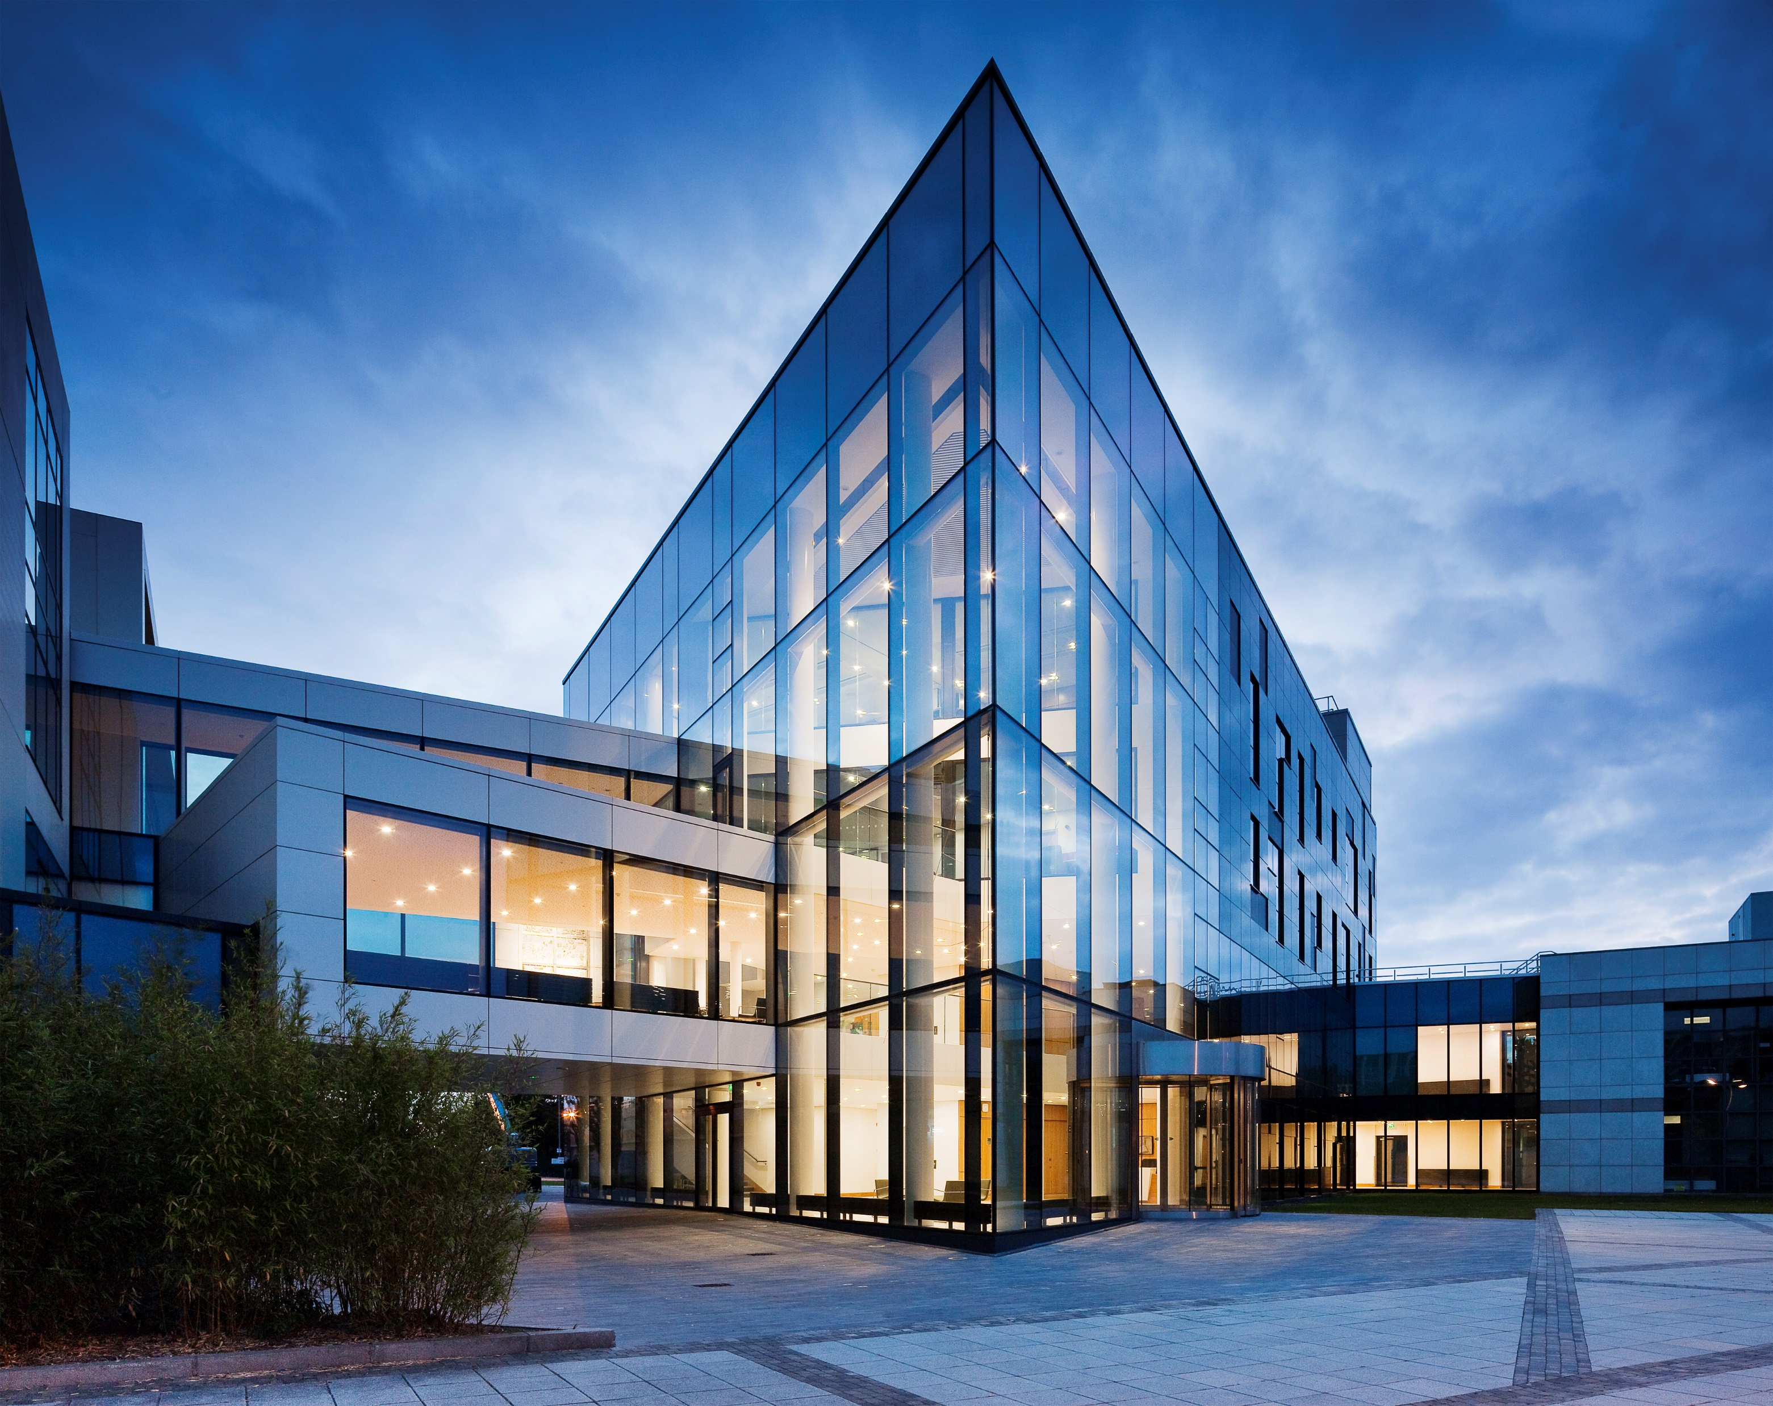



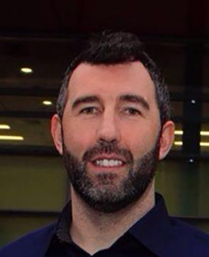
Ireland’s National Dermatology
Research & Education Centre
The Charles Institute Seminar Series
Wednesday 28th September 2022 @ 12 noon
Charles Seminar Room & Online via Zoom
Investigating a role for MAIT cells in the pathogenesis of Hidradenitis suppurativa
Dr. Andrew E. Hogan,
Associate Professor & Principal Investigator,
Lonsdale Human Health Institute, Department of Biology
Maynooth University
BIO: After completing his PhD training with Prof Derek Doherty at Maynooth University investigating human iNKT cell biology. Dr Hogan joined the group of Prof Donal O’Shea at St Vincent’s University Hospital as Newman Fellow, where he worked on the impact of obesity on immune populations including NK cells, MAIT cells and Dendritic cells. In 2012 he was awarded a senior fellowship by the National Children’s Research Centre to investigate immune dysregulation in children with obesity. In 2017, he returned to Maynooth University and is now an Associate Professor of Immunology. His research focuses on the metabolic regulation of MAIT cells and their role in chronic human diseases such as obesity, H.S and cancer. The goal is to unravel the environmental drivers of immune dysregulation in disease, and identify novel therapeutic strategies.
Abstract: Hidradenitis Suppurativa (HS) is a chronic inflammatory disease of the hair follicles, resulting in painful lesions of apocrine-bearing skin. Several inflammatory cytokines have been implicated in the pathogenesis of HS including IL-17. Mucosal Associated Invariant T (MAIT) cells are a population of unconventional “innate” T cells, which are capable of robust cytokine secretion in a T cell receptor dependent or independent manner. Upon activation, MAIT cells can rapidly secrete a milieu of cytokines including IL-17. MAIT cells have been reported in the gut, periphery and skin. Recent research has highlighted their involvement in numerous inflammatory diseases including rheumatoid arthritis, obesity and psoriasis. The role of MAIT cells in HS is currently unknown.
  *The Charles Institute Seminar Series is kindly supported by RELIFE. RELIFE had no input into the content of the Series.

